Slide 1
Sociology: 3549 CHI SQUARE
Recitation #13
Yue Chu

Slide 2
announcement
Final grading policy has changed, please refer to Hui’s class announcement for details.
Last lab session will be recap, we will briefly cover Stata, and leave time for Q&A.
Thanksgiving week stats tutoring hours:
Monday - 12:30-2:00pm, 3:00-5:00pm
Tuesday - 3:30-5:30pm
Wednesday - 9:30am-12:30pm
Happy holiday!

Slide 3
agenda
Review of lecture
Activity
Chi-square
In class exercise
Upload your answer to Carmen for today’s lab attendance

Slide 4
Hypothesis testing
Z-test, t-test or ANOVA
Testing difference in means between groups
Testing association between categorical and continuous variable
Independent var. (IV): categorical variable
Dependent var. (DV): continuous variable
E.g. test score between genders, birth weight between birth cohorts
Chi-square test:
Testing association between two categorical variables
Testing difference in frequency distribution of DV between groups of IV

Slide 5
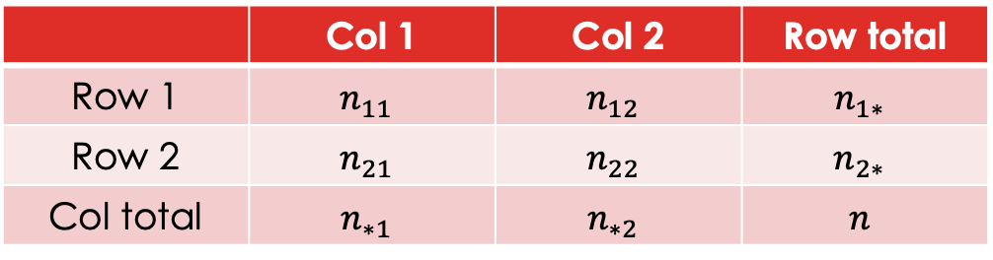
Cross-tabulation of IV & DV
Cross-tabulation of two categorical variables
Showing frequency distributions by groups/categories
Row total
Column total
Total sample size (n)
 | Col 1 | Col 2 | Row total
Row 1 | $$n_{11}$$ | $$n_{12}$$ | $$n_{1∗}$$
Row 2 | $$n_{21}$$ | $$n_{22}$$ | $$n_{2∗}$$
Col total | $$n_{∗1}$$ | $$n_{∗2}$$ | $$n$$

Slide 6


$χ^{2}$ test
Test whether there are any statistically significant differences in frequency distribution of dependent variable across independent variable groups.
$H_{0}:$ Frequency distributions from all groups are the same.
$H_{1}:$ Not all frequency distributions from IV groups are the same.
Test whether there are any statistically significant association between two categorical variables.
$H_{0}:$ There is no statistically significant association between IV and DV.
$H_{1}:$ There is statistically significant association between IV and DV.
Evaluate the extent that “observed” frequencies differ from “expected” frequencies under the assumption of no association between IV and DV.
Notes:
The chi-square statistic compares the observed count in each table cell to the count which would be expected under the assumption of no association between the row and column classifications

Slide 7

Steps for test hypothesis – $χ^{2}$ test
State
State hypothesis (H₀ vs H₁)
Sig.
Calculate
Collect sample and compute test statistics$χ^{2}$
Collect sample and compute test statistics 𝜒^2
Decide
whether reject / fail to reject H₀
Set significance level ($α$)
Set significance level (𝜶)
decide critical values & critical region using $χ^{2}$ distribution.
decide critical values & critical region using 𝜒^2 distribution.

Slide 8
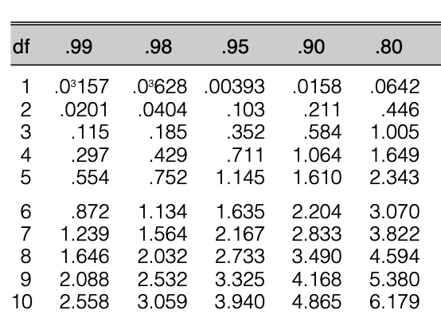


Critical value and $χ^{2}$ distribution
Critical value is determined by $χ^{2}$ distribution (Appendix table C)
Degree of freedom (df)
Number of row (R), number of column (C)
$$df=(R−1)(C−1)$$
Find critical value $χ_{critical}^{2}$ given df and significance level $α$
Column: $α$; Row: df

Slide 9
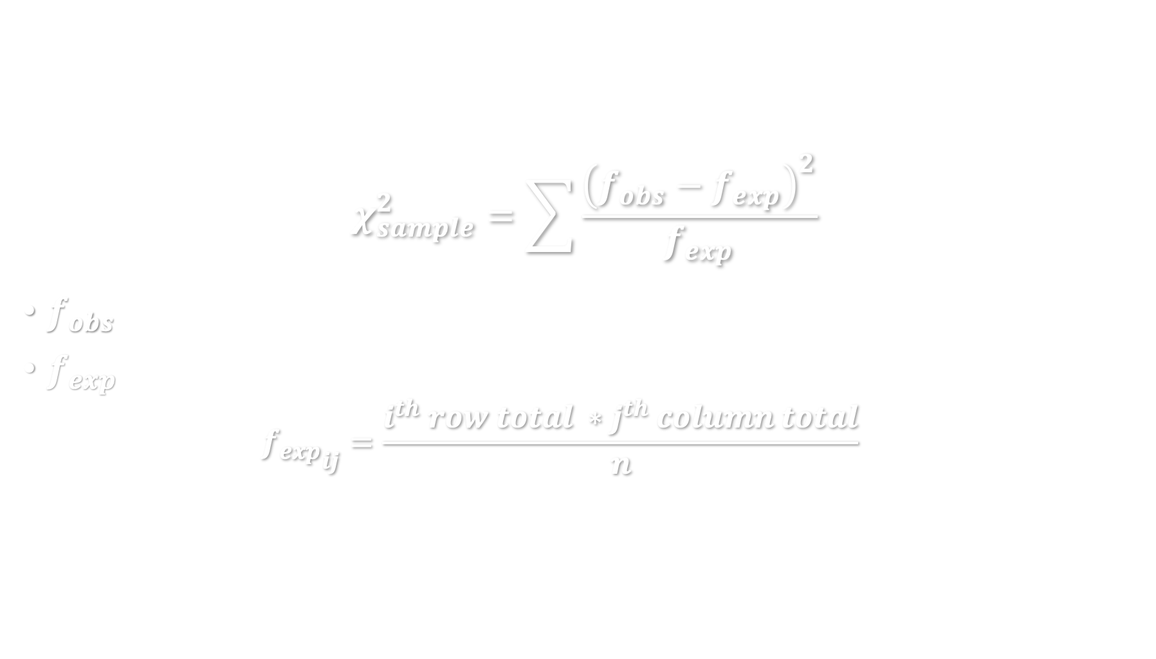
$χ^{2}$ for sample
$$χ_{sample}^{2}=\sum{\frac{{\left(f_{obs}−f_{exp}\right)}^{2}}{f_{exp}}}$$
$f_{obs}$ : observed frequencies;
$f_{exp}$: expected frequencies, for each cell in a two-way table:
$${f_{exp}}_{ij}=\frac{i^{th} row total ∗j^{th} column total}{n}$$
n is total sample size.

Slide 10

conclusion
$χ_{sample}^{2}$> $χ_{critical}^{2}$
We reject the null hypothesis $H_{0}$;
Conclusion: there is statistically sig. association between IV and DV at sig. level $α$.
$χ_{sample}^{2}≤χ_{critical}^{2}$
We fail to reject $H_{0}$.
Conclusion: no statistically sig. association between IV and DV at sig. level $α$.
Interpret the test result given your research question.

Slide 11
example
CHI-SQUARE TEST

Slide 12

Covid vaccine EXAMPLE
Public health experts want to assess the safety of a candidate COVID-19 vaccine. They recruited 508 healthy adults (≥18 years) who were HIV-negative and COVID-infection free, and randomly assigned them to one of the three groups: low-dose vaccine, high-dose vaccine, or placebo. ($α=0.05$) (Zhu et al. 2020)
Solicited adverse reaction within 14 days | High-dose Vaccine | Low-dose Vaccine | Placebo | Total
Any | 183 | 96 | 46 | 325
None | 70 | 33 | 80 | 183
Total | 253 | 129 | 126 | 508
Notes:
Zhu, Feng-Cai, Xu-Hua Guan, Yu-Hua Li, Jian-Ying Huang, Tao Jiang, Li-Hua Hou, Jing-Xin Li et al. "Immunogenicity and safety of a recombinant adenovirus type-5-vectored COVID-19 vaccine in healthy adults aged 18 years or older: a randomised, double-blind, placebo-controlled, phase 2 trial." The Lancet 396, no. 10249 (2020): 479-488.

Slide 13

hypothesis
Test whether there are any statistically significant association between COVID-vaccination and occurrence of solicited adverse reaction within 14 days.
$H_{0}:$ There is no statistically significant difference between COVID vaccination and occurrence of adverse reaction.
$H_{1}:$ There is statistically significant difference between COVID vaccination and occurrence of adverse reaction.

Slide 14
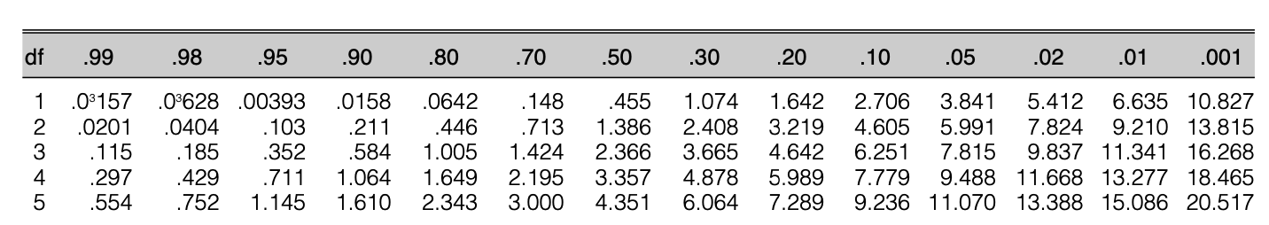


$χ_{critical}^{2}$
Degree of freedom (df)
3 treatment groups, 2 possible outcomes (any, none)
$$df=\left(R−1\right)\left(C−1\right)=\left(2−1\right)\left(3−1\right)=2$$
Find critical value given df=2 and $α=0.05$ (Appendix table C)
$χ_{critical}^{2}$=5.991

Slide 15

Expected values
Solicited adverse reaction within 14 days |  | High-dose Vaccine | Low-dose Vaccine | Placebo | Row Total
Any | Obs | 183 | 96 | 46 | 325
 | Exp | 325*253/508 =161.9 | 325*96/508 =82.5 | 325*46/508 =80.6
None | Obs | 70 | 33 | 80 | 183
 | Exp | 183*253/508 =91.1 | 183*96/508 =46.5 | 183*46/508 =45.4
Column total |  | 253 | 129 | 126 | n=508
$f_{exp}$: expected frequencies, for each cell in a two-way table:
$${f_{exp}}_{ij}=\frac{i^{th} row total ∗j^{th} column total}{n}$$
Notes:
Zhu, Feng-Cai, Xu-Hua Guan, Yu-Hua Li, Jian-Ying Huang, Tao Jiang, Li-Hua Hou, Jing-Xin Li et al. "Immunogenicity and safety of a recombinant adenovirus type-5-vectored COVID-19 vaccine in healthy adults aged 18 years or older: a randomised, double-blind, placebo-controlled, phase 2 trial." The Lancet 396, no. 10249 (2020): 479-488.

Slide 16
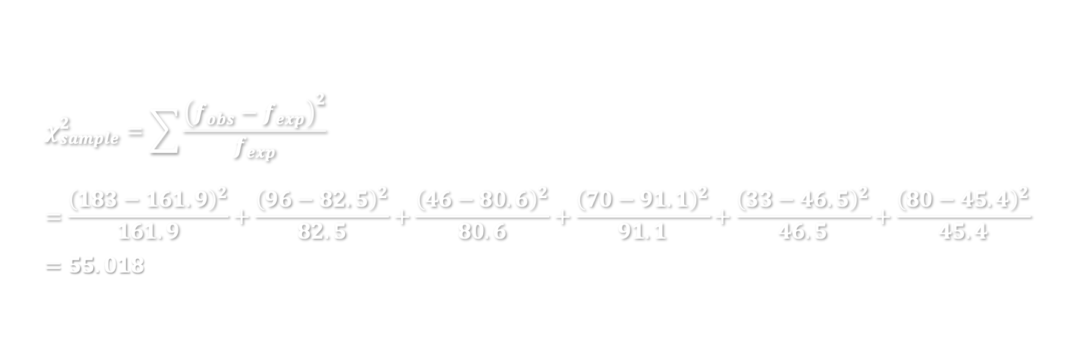
$χ_{sample}^{2}$
Solicited adverse reaction within 14 days |  | High-dose Vaccine | Low-dose Vaccine | Placebo | Row Total
Any | Obs | 183 | 96 | 46 | 325
 | Exp | 161.9 | 82.5 | 80.6
None | Obs | 70 | 33 | 80 | 183
 | Exp | 91.1 | 46.5 | 45.4
Column total |  | 253 | 129 | 126 | n=508
$$χ_{sample}^{2}=\sum{\frac{{\left(f_{obs}−f_{exp}\right)}^{2}}{f_{exp}}}=\frac{{\left(183−161.9\right)}^{2}}{161.9}+\frac{{\left(96−82.5\right)}^{2}}{82.5}+\frac{{\left(46−80.6\right)}^{2}}{80.6}+\frac{{\left(70−91.1\right)}^{2}}{91.1}+\frac{{（33−46.5）}^{2}}{46.5}+\frac{{\left(80−45.4\right)}^{2}}{45.4}=55.018$$
Notes:
Zhu, Feng-Cai, Xu-Hua Guan, Yu-Hua Li, Jian-Ying Huang, Tao Jiang, Li-Hua Hou, Jing-Xin Li et al. "Immunogenicity and safety of a recombinant adenovirus type-5-vectored COVID-19 vaccine in healthy adults aged 18 years or older: a randomised, double-blind, placebo-controlled, phase 2 trial." The Lancet 396, no. 10249 (2020): 479-488.

Slide 17

conclusion
$χ_{sample}^{2}=55.018>χ_{critical}^{2}=5.991$
We reject the null hypothesis $H_{0}$;
Conclusion: At significance level of 0.05, there is statistically significant difference between COVID vaccination and occurrence of solicitated adverse reaction within 14 days.
However, does it mean this new COVID vaccine is “unsafe” to use?
Interpretation needs to be related to the context and research question.
Outcome is rough – any reaction vs none reaction, without specifying type of reaction, duration and severity.
Researchers further found that most reactions reported post vaccination were mild or moderate, and resolved quickly. So they concluded overall safe profile.

Slide 18

In-class exercise
COVID example
In the same study, author also examined the mostly commonly occurred reaction – fatigue. Replicate their test, and see whether there were any statistically significant association between COVID-vaccination and occurrence of fatigue within 14 days.
Question
Test your hypothesis at significant level $α$= 0.05
You’d need to complete the table above first. (don’t need to upload this to Carmen)
Write down your $χ_{sample}^{2}$ and state your conclusion.
Upload your answer in Carmen – Lab attendance
Fatigue within 14 days | High-dose Vaccine | Low-dose Vaccine | Placebo | Row Total
Any | 106 | 44 | 21
None
Column Total | 253 | 129 | 126 | 508

